Slide 1
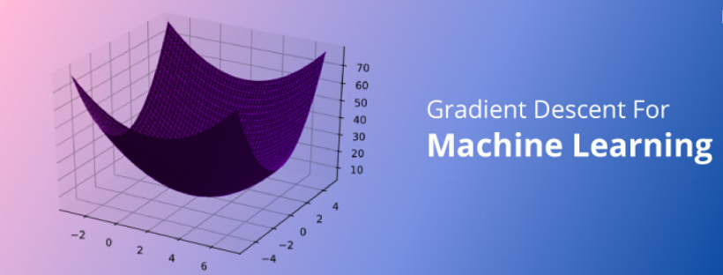

Slide 2
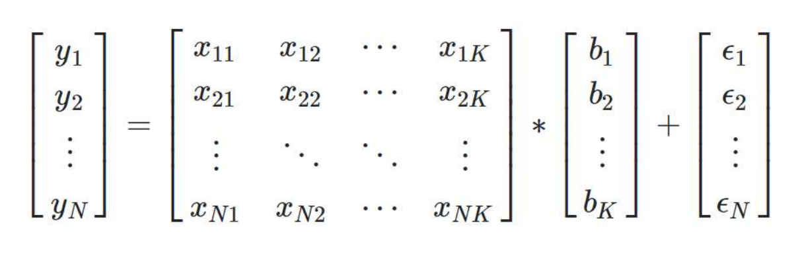
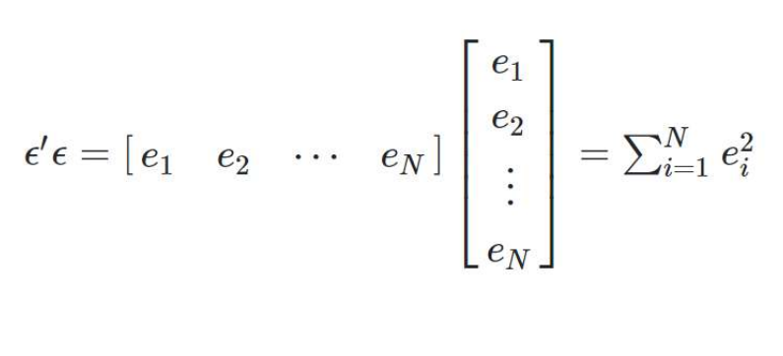
we want to reduce the error !

Slide 3
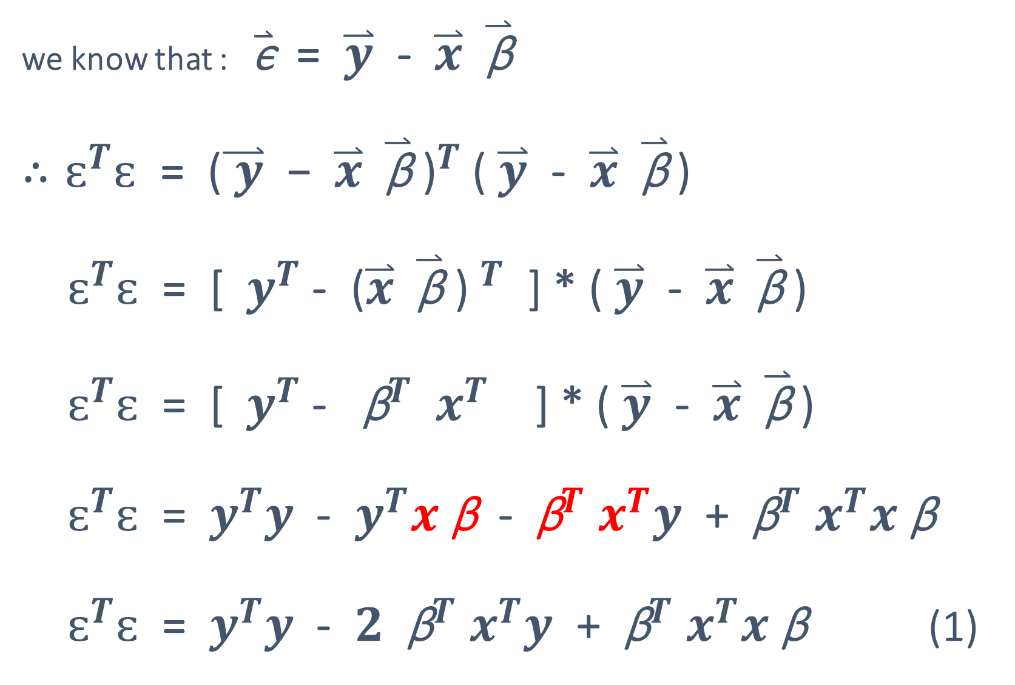
we know that : $\overset{⃑}{\text{ϵ}}$ = $\overset{⃑}{y}$ - $\overset{⃑}{x} \overset{⃑}{\text{β}}$ $∴ԑ^{T}ԑ$ = ${\text{(}\overset{⃑}{ y}\text{ − }\overset{⃑}{x} \overset{⃑}{\text{β}} \text{)}}^{T}$ ( $\overset{⃑}{y}$ - $\overset{⃑}{x} \overset{⃑}{\text{β}}$ ) $ԑ^{T}ԑ$ = [ $y^{T}$ - ${\text{(}\overset{⃑}{x} \overset{⃑}{\text{β}}\text{ ) }}^{T}$ ] * ( $\overset{⃑}{y}$ - $\overset{⃑}{x} \overset{⃑}{\text{β}}$ ) $ԑ^{T}ԑ$ = [ $y^{T}$ - ${ \text{β}}^{T}$ $x^{T}$ ] * ( $\overset{⃑}{y}$ - $\overset{⃑}{x} \overset{⃑}{\text{β}}$ ) $ԑ^{T}ԑ$ = $y^{T}y$ - $y^{T}x \text{β}$ - ${ \text{β}}^{T}$ $x^{T}y$ + ${ \text{β}}^{T}$ $x^{T}x \text{β}$ $ԑ^{T}ԑ$ = $y^{T}y$ - $2$ ${ \text{β}}^{T}$ $x^{T}y$ + ${ \text{β}}^{T}$ $x^{T}x \text{β}$ (1)

Slide 4
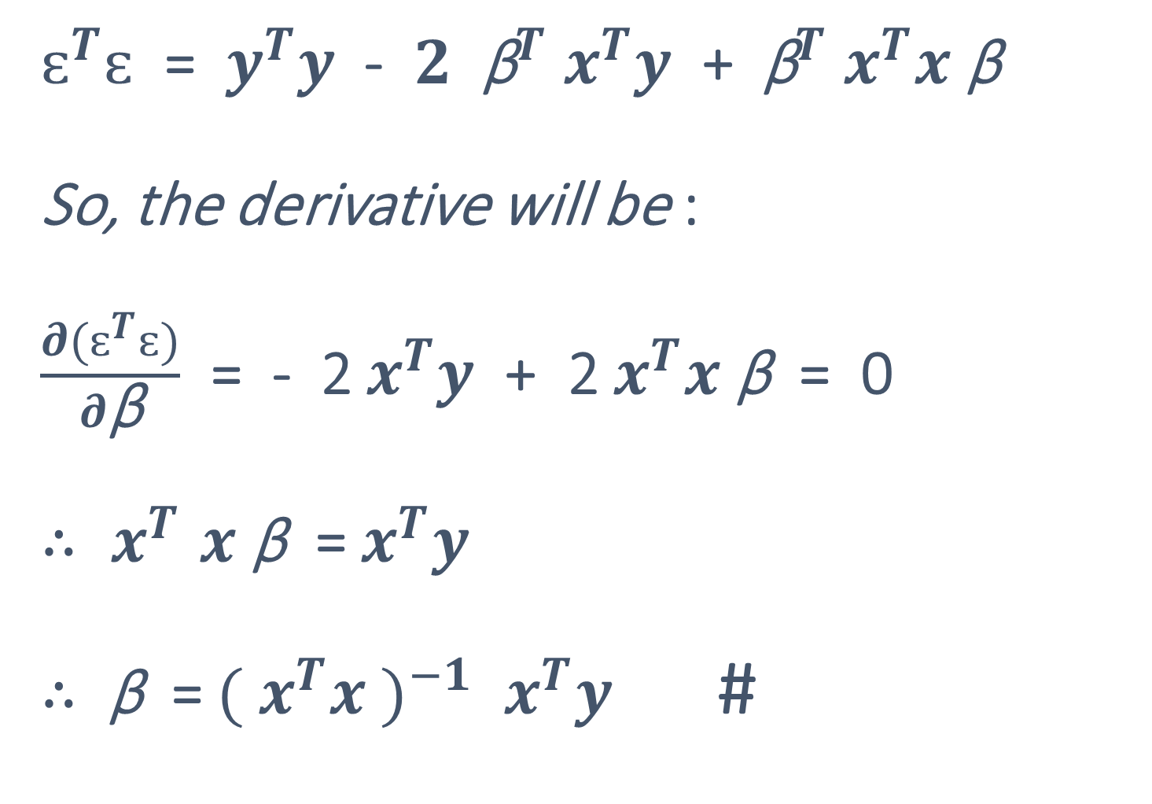
$ԑ^{T}ԑ$ = $y^{T}y$ - $2$ ${ \text{β}}^{T}$ $x^{T}y$ + ${ \text{β}}^{T}$ $x^{T}x \text{β}$ So, the derivative will be : $\frac{∂(ԑ^{T}ԑ)}{∂\text{β}}$ = - 2 $x^{T}y$ + 2 $x^{T}x \text{β}$ = 0 ${∴ x}^{T}x \text{β}$ = $x^{T}y$ $∴$ $\text{β}$ = ${({ x}^{T}x )}^{−1}$ $x^{T}y$ #
(1)

Slide 5

What’s The Problem with the Normal Equation ?

Slide 6


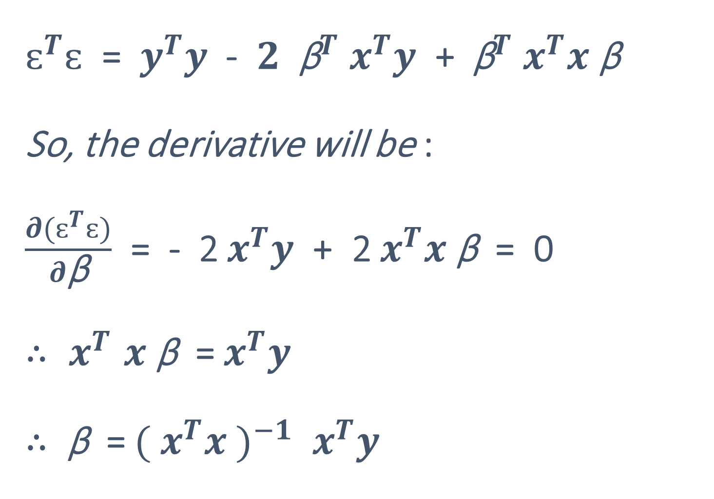

$ԑ^{T}ԑ$ = $y^{T}y$ - $2$ ${ \text{β}}^{T}$ $x^{T}y$ + ${ \text{β}}^{T}$ $x^{T}x \text{β}$ So, the derivative will be : $\frac{∂(ԑ^{T}ԑ)}{∂\text{β}}$ = - 2 $x^{T}y$ + 2 $x^{T}x \text{β}$ = 0 ${∴ x}^{T}x \text{β}$ = $x^{T}y$ $∴$ $\text{β}$ = ${({ x}^{T}x )}^{−1}$ $x^{T}y$
(1)

Slide 7
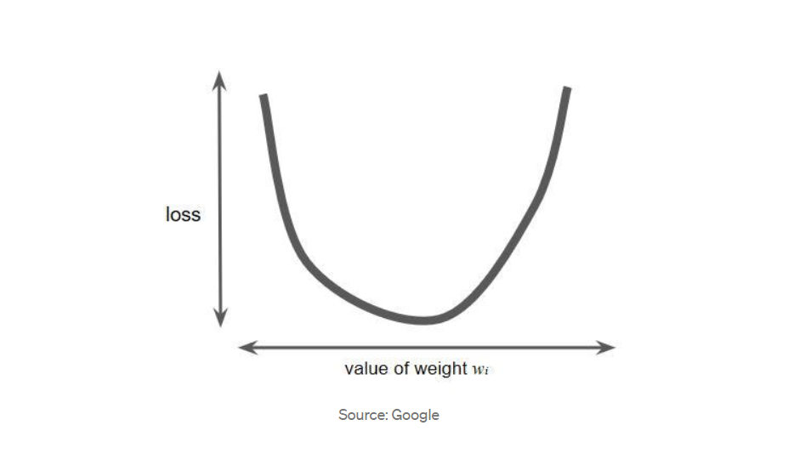

Slide 8
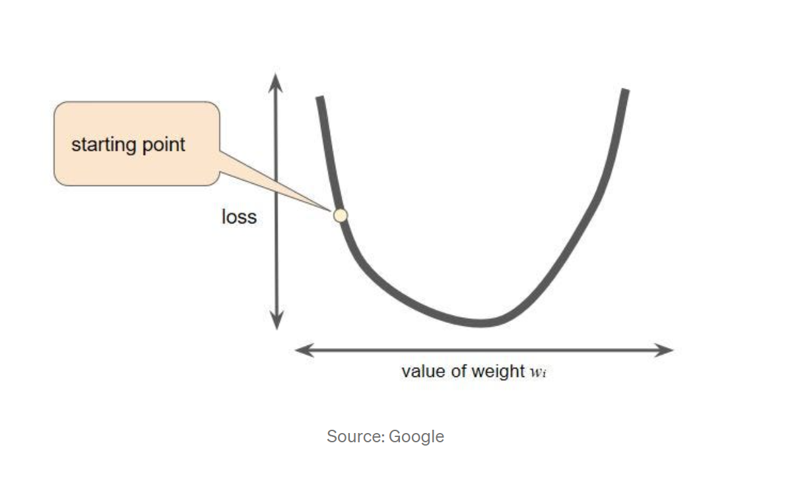

Slide 9
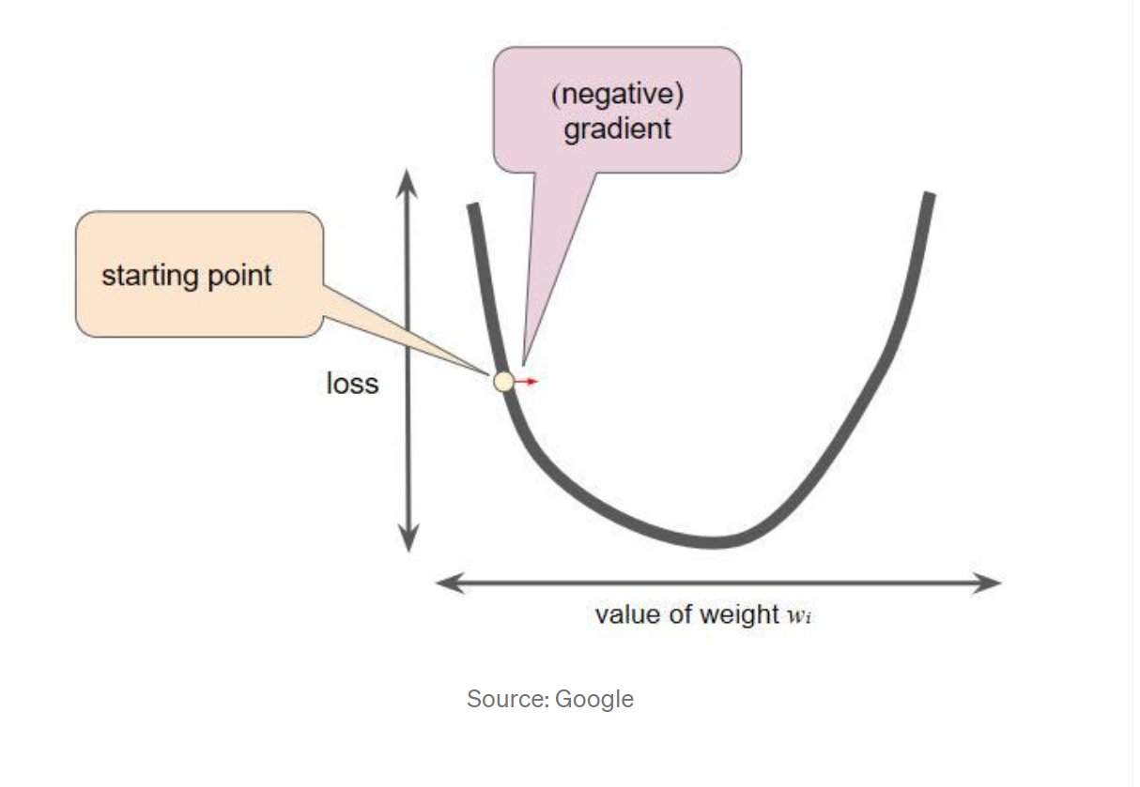

Slide 10
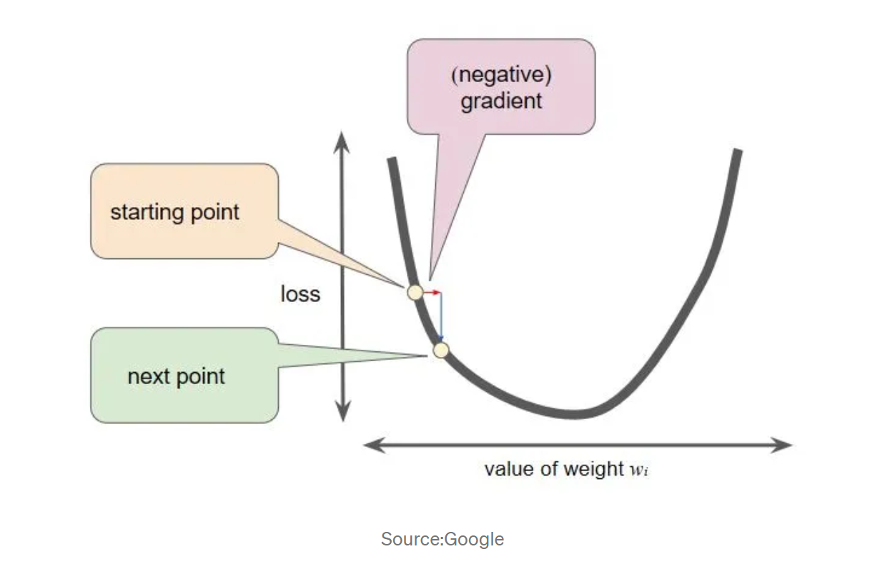

Slide 11
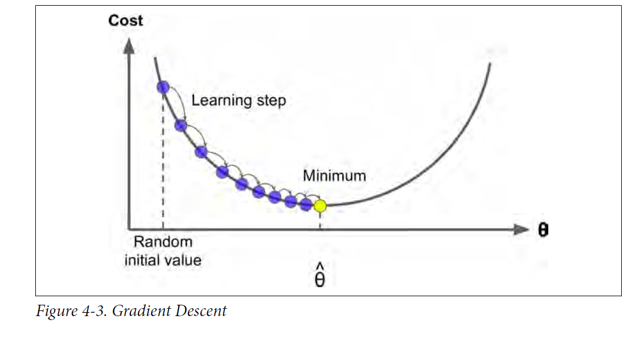

Slide 12
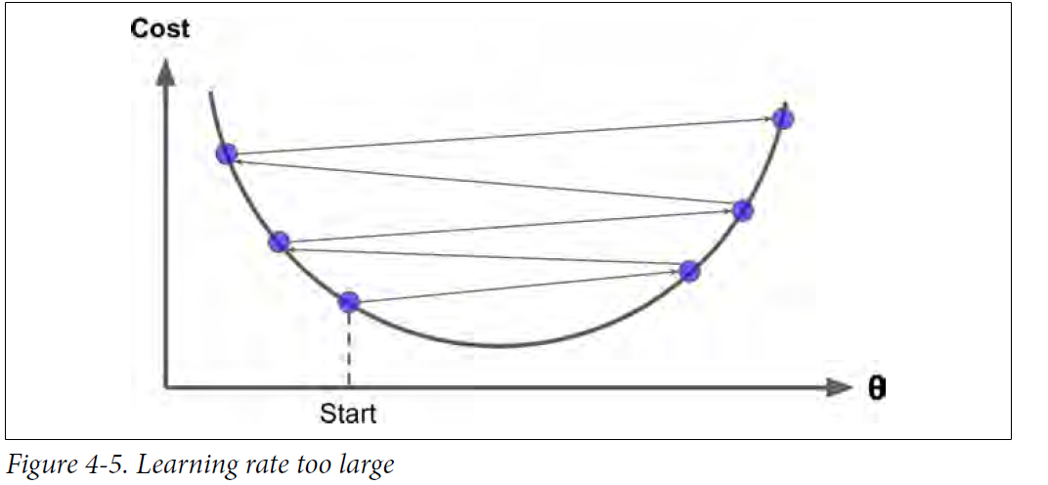

Slide 13
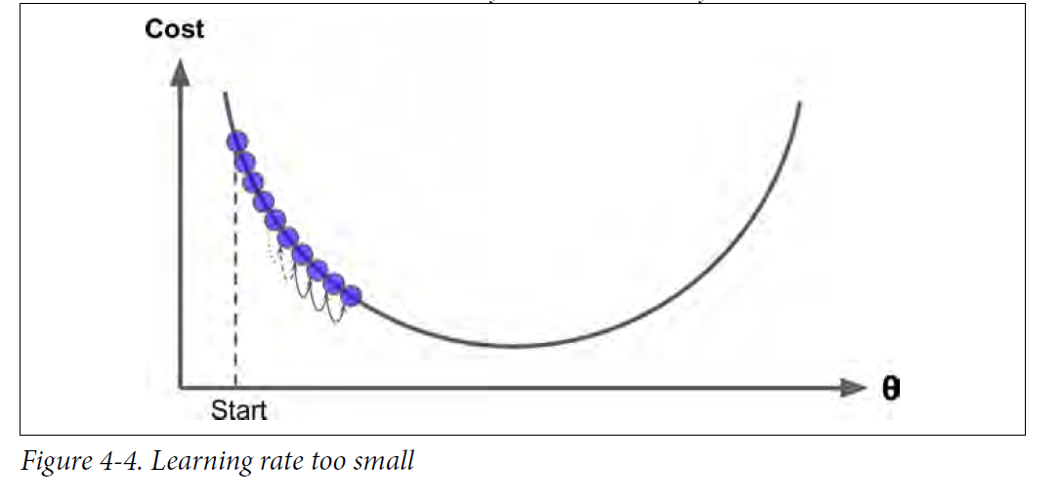

Slide 14
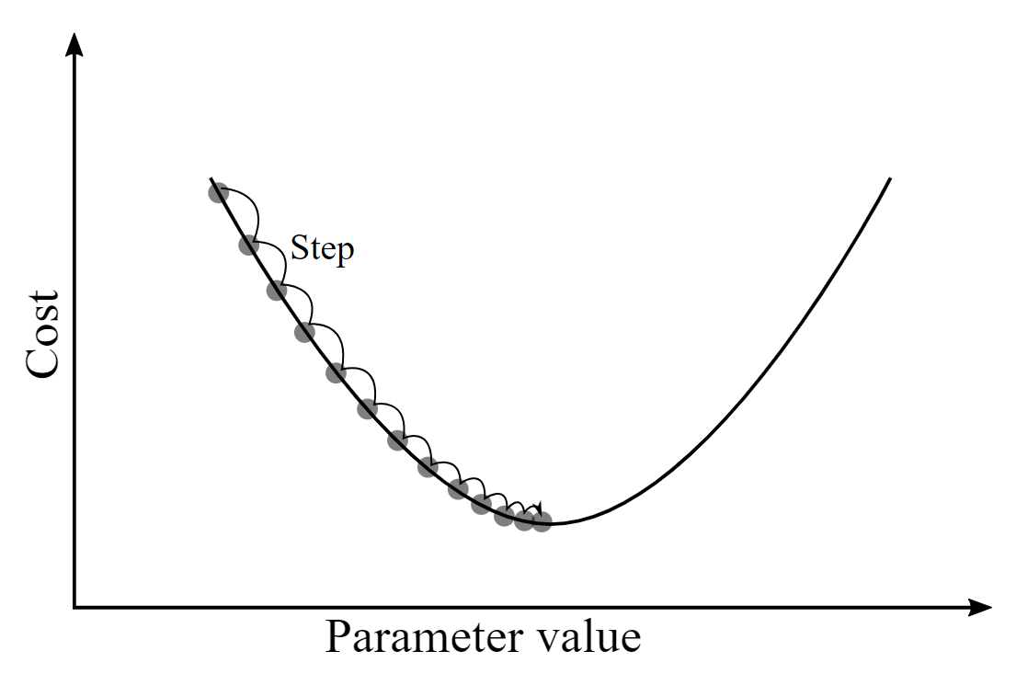
Gradient Descent Algorithm

Slide 15

It aims to minimize a function by iteratively moving in the direction of steepest descent of the function's gradient.

Slide 16
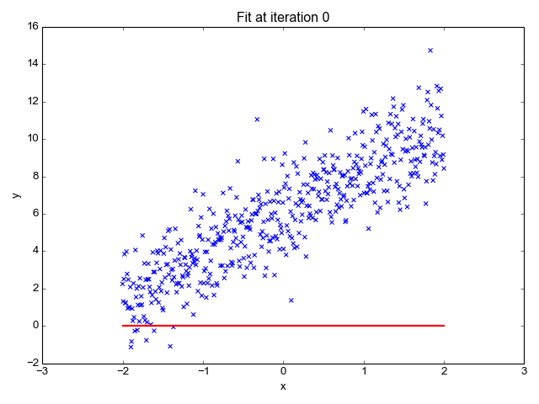
Linear Regression

Slide 17
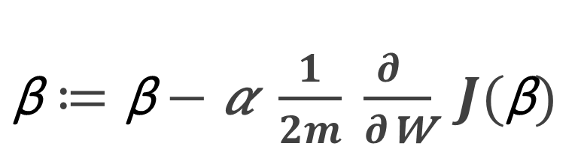
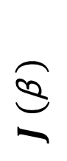
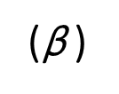
$\text{β}≔\text{β}−$𝛼 $\frac{1}{2m} \frac{∂ }{∂\text{w}}$ $J(\text{β})$
Gradient Descent Algorithm
$J$ $(\text{β} )$
(𝛼) => learning rate
($\text{β}$ )

Slide 18
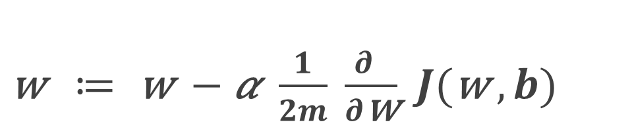
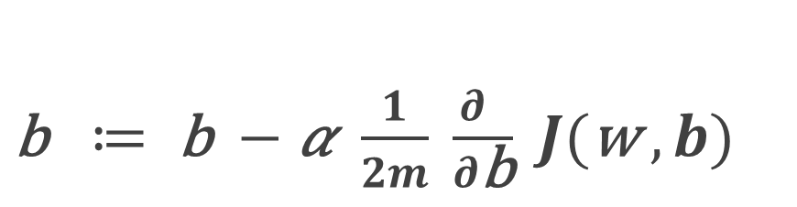
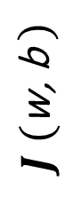
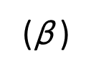
$\text{w} ≔ \text{w} −$𝛼 $\frac{1}{2m} \frac{∂ }{∂\text{w}}$ $J(\text{w} , b)$
Gradient Descent Algorithm
$J$ $(\text{w}\text{, }\text{b} )$
(𝛼) => learning rate
$\text{b} ≔ \text{b} −$𝛼 $\frac{1}{2m} \frac{∂ }{∂\text{b}}$ $J(\text{w} , b)$
($\text{β}$ )

Slide 19
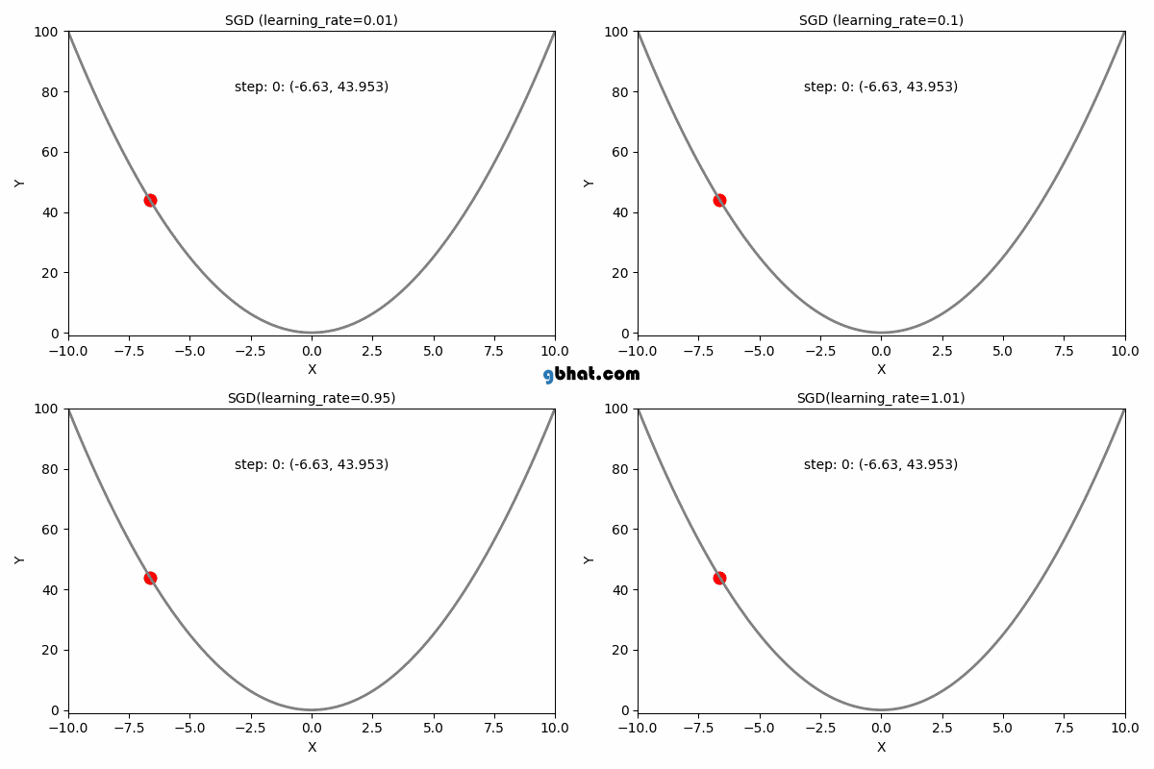
Learning Rate Effect :

Slide 20
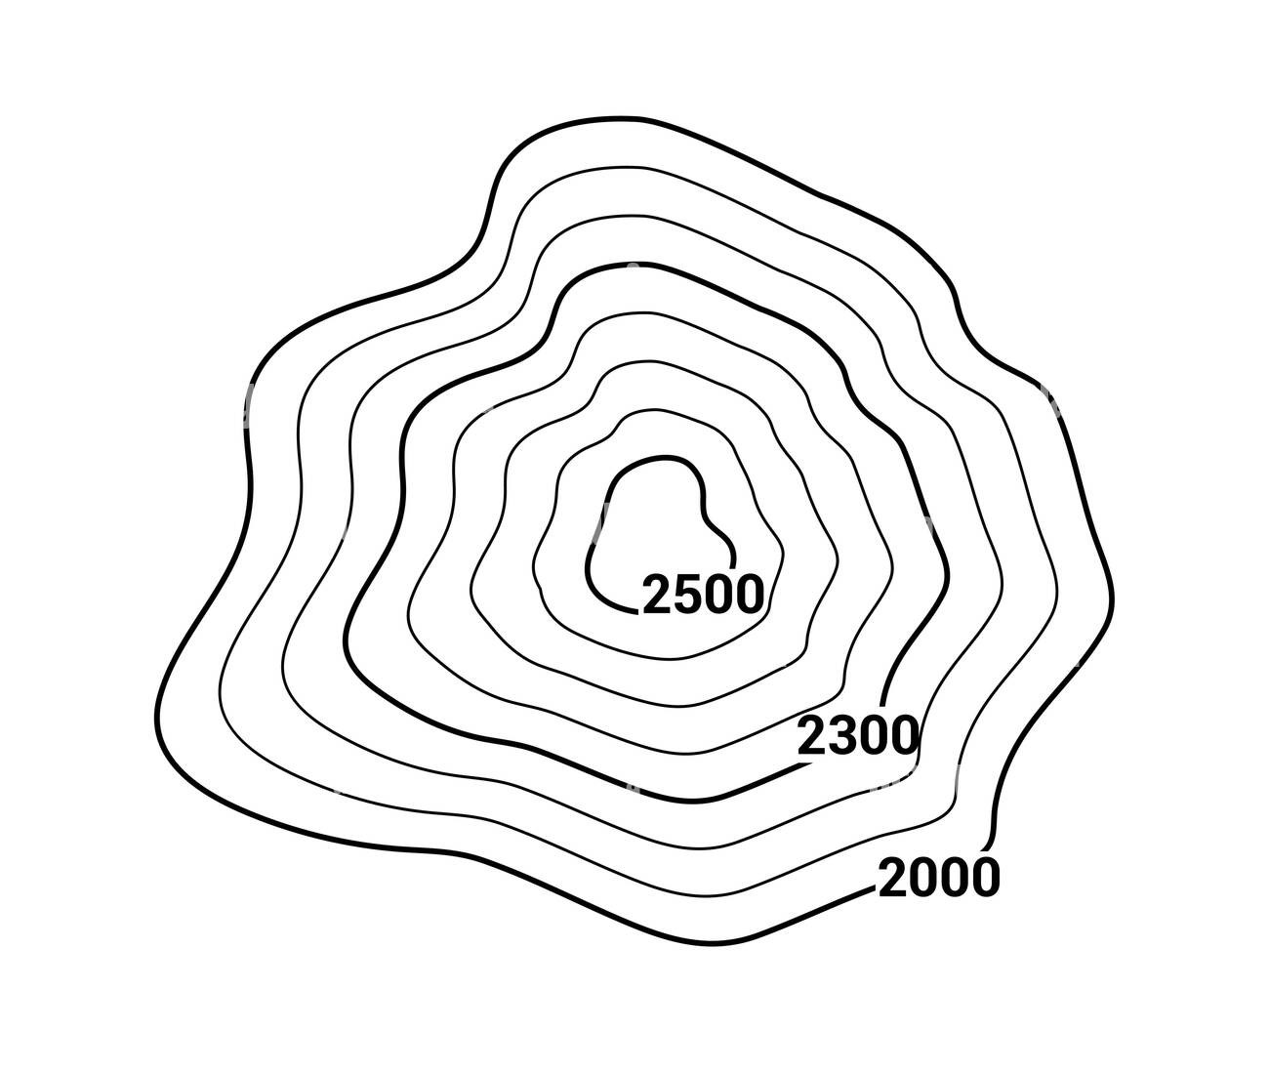
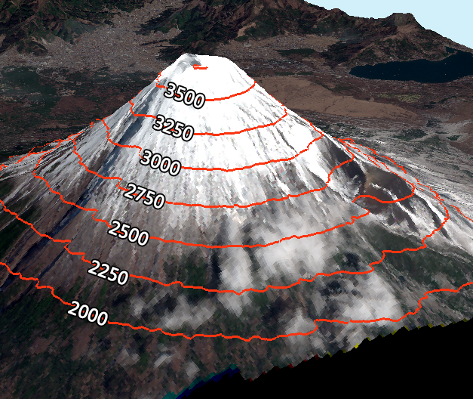
Contour Plot

Slide 21
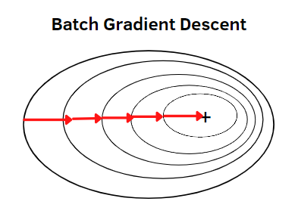
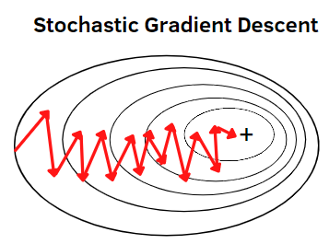
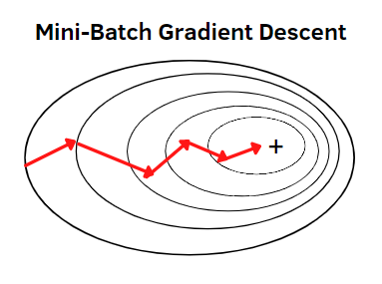
Types of Gradient Descent
updates the parameters using the entire dataset at each iteration. Very slow with more data
updates the parameters using a single randomly chosen sample from the dataset at each iteration.
Very Fast
updates the parameters using a group of samples from the dataset at each iteration.
It offers a balance between BGD & SGD

Slide 22
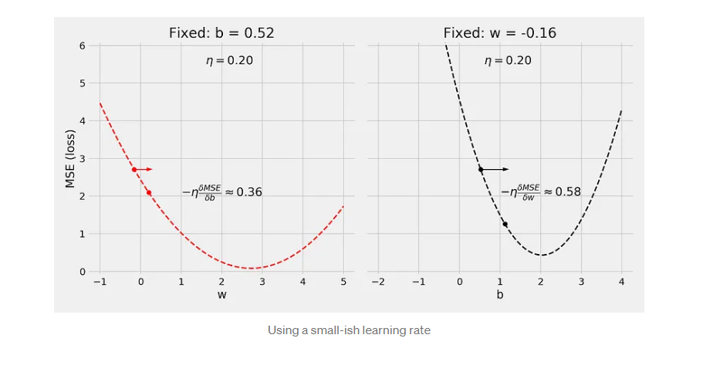

Slide 23
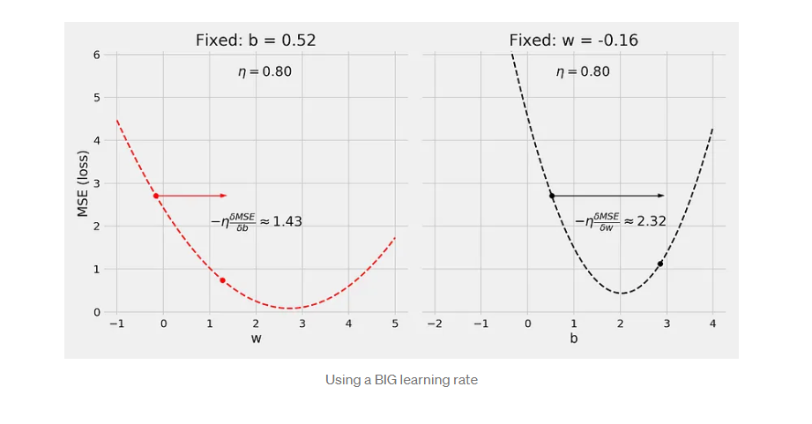

Slide 24
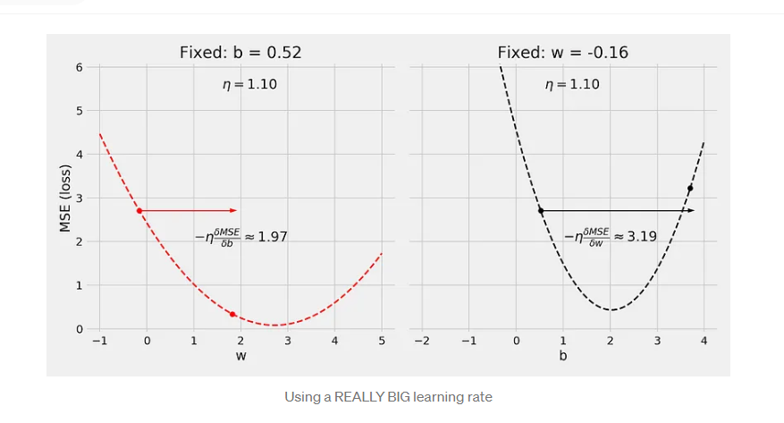

Slide 25
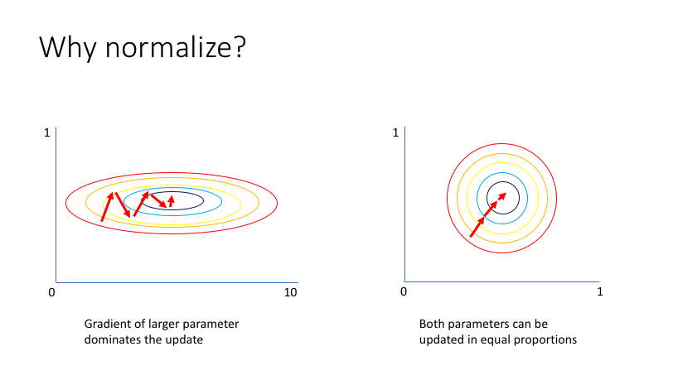

Slide 26


Slide 27
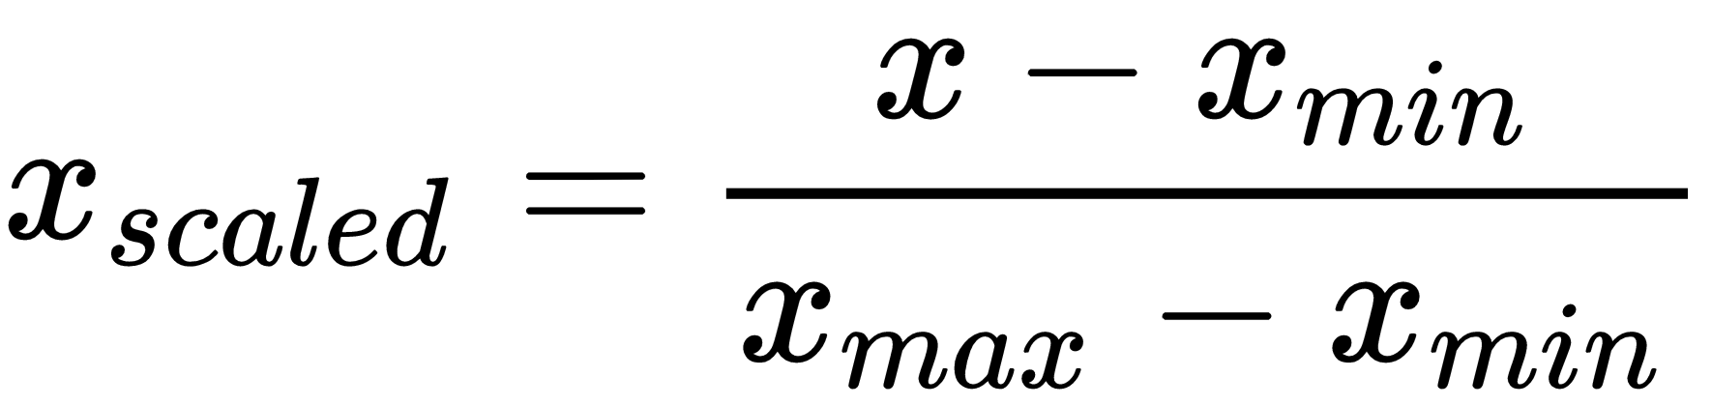
Scaling by Normalization ( min max scaling )

Slide 28
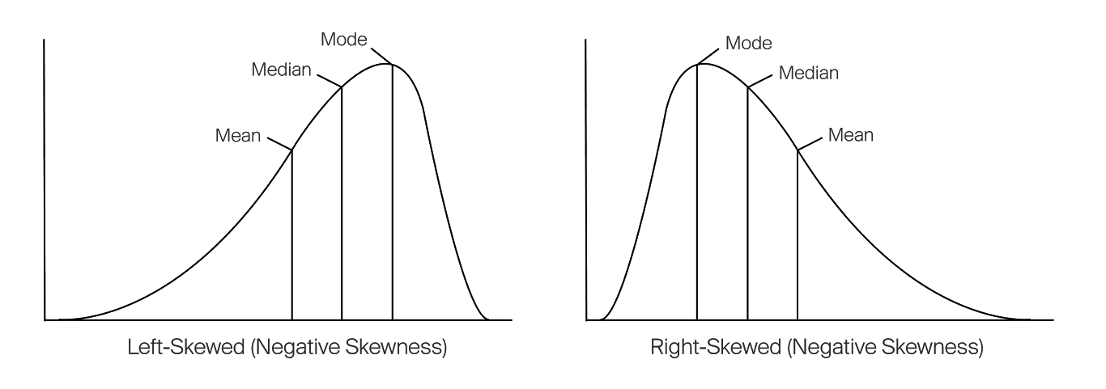
Left & Right Skewed distributions

Slide 29
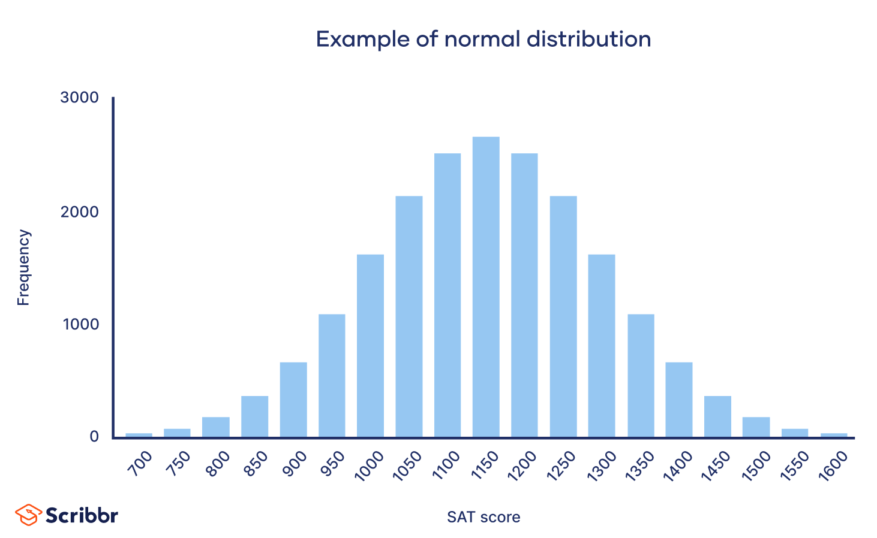


Slide 30
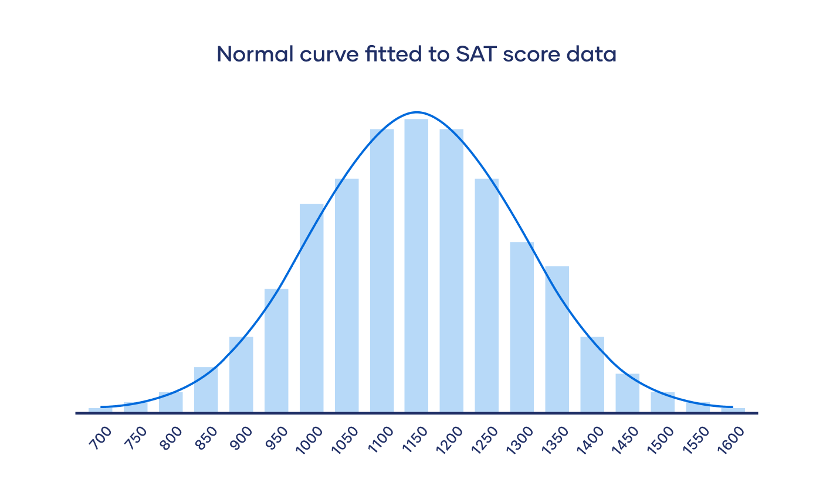

Slide 31
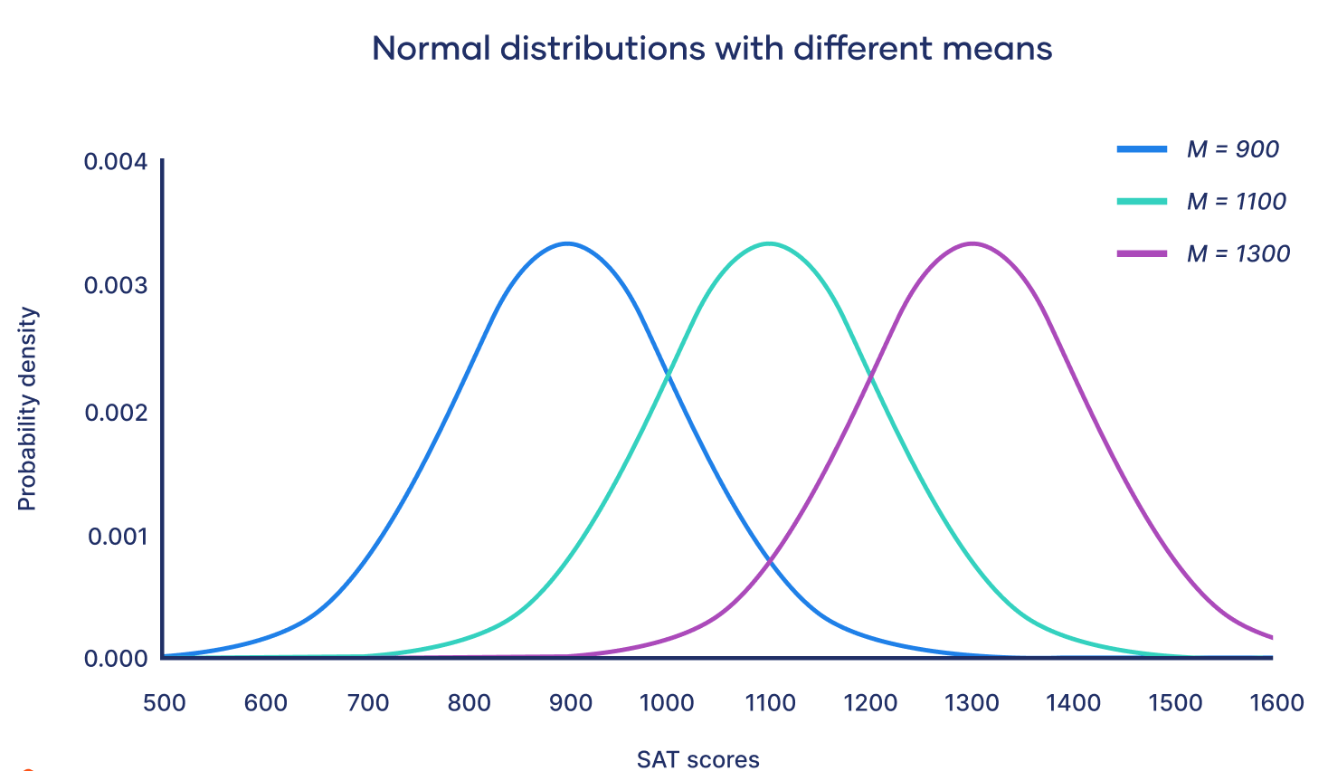

Slide 32
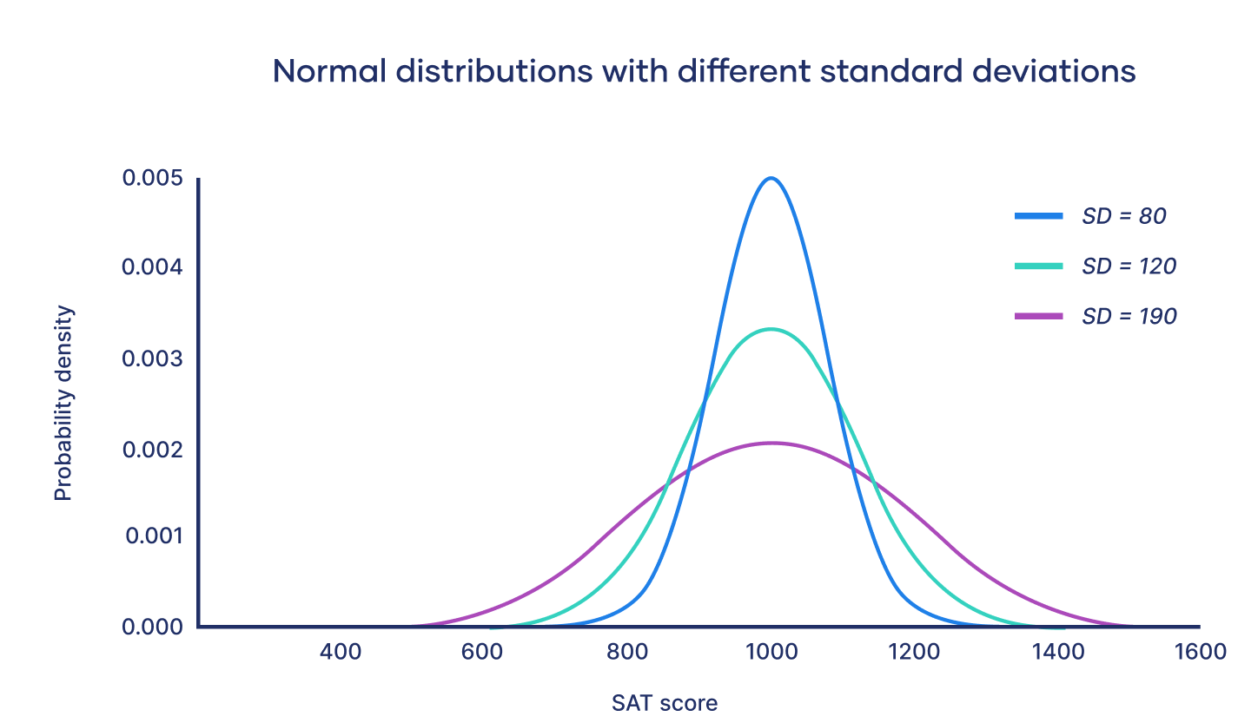

Slide 33
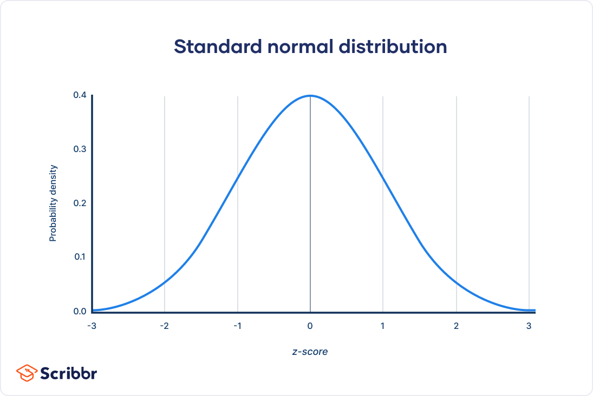

Slide 34
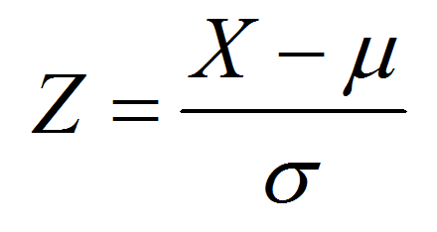
Scaling by Standardization ( Z score )

Slide 35
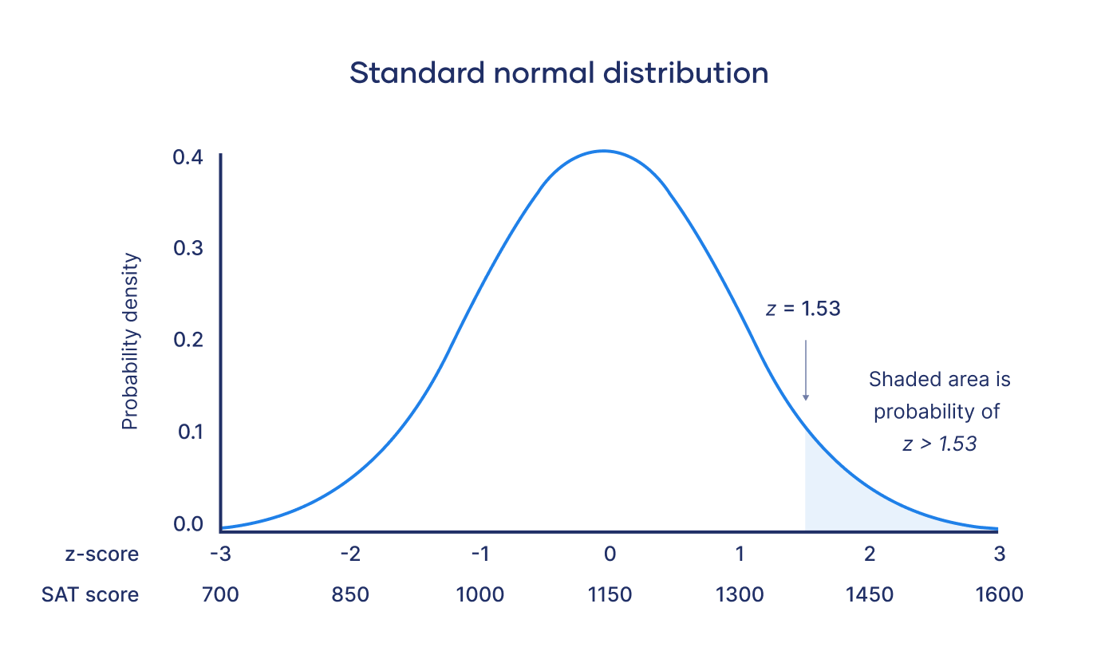

Slide 36
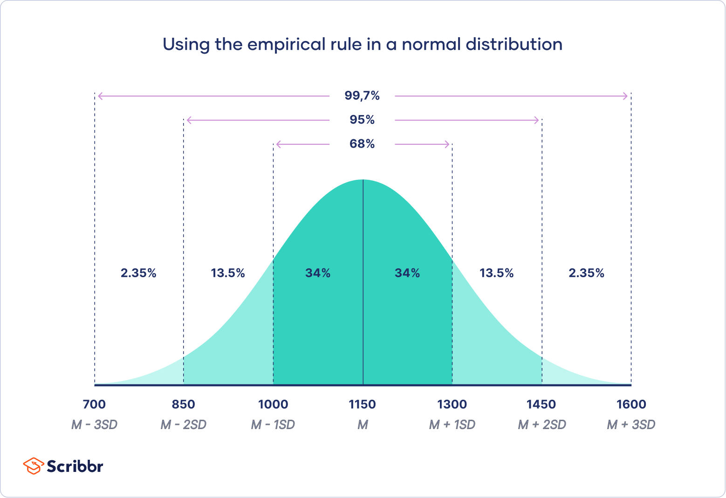

Slide 37
Z-score -3 -2 -1 0 1 2 3

Slide 38
Thank you

